Slide 1
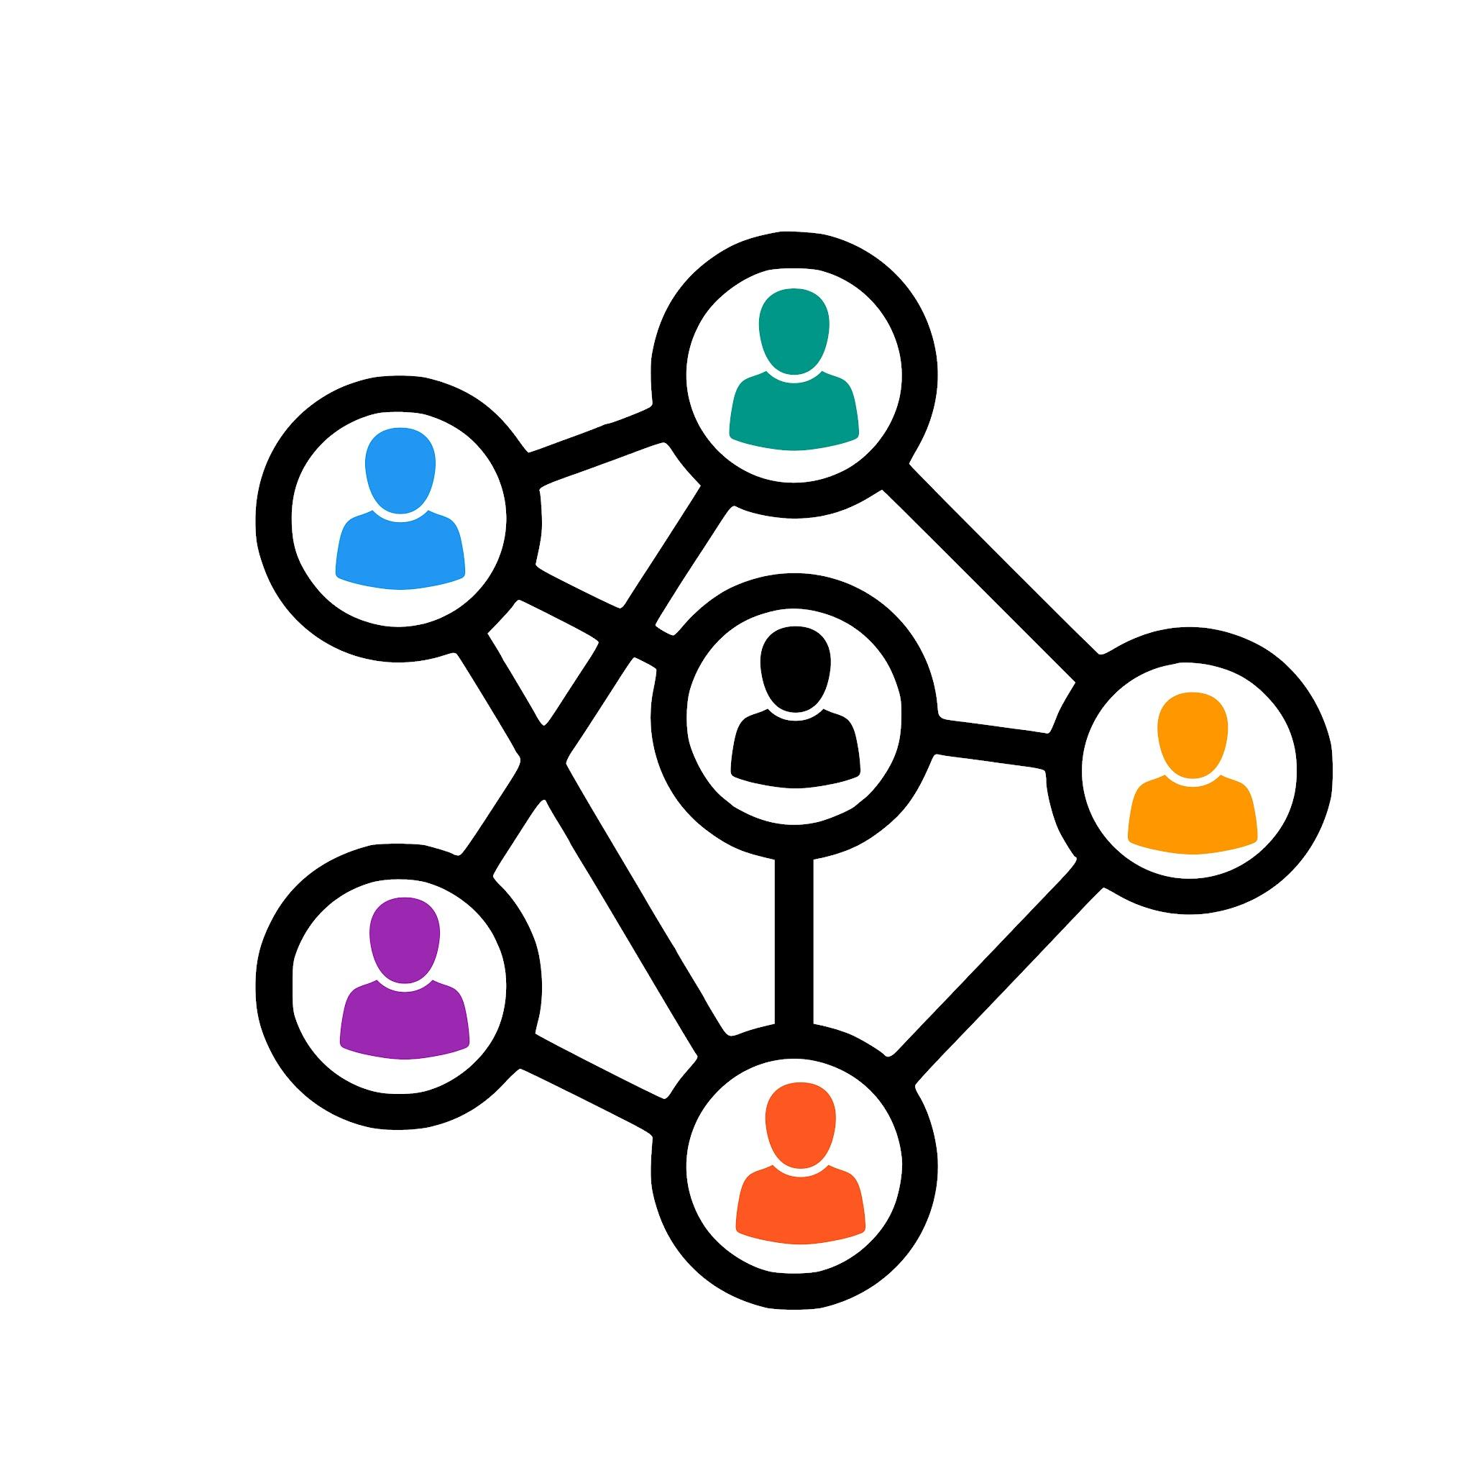
Outreach & Communication
Toolkit for Teachers

Slide 2
A word about this toolkit.
MVLA is a district that provides excellent programs and experiences for our students and their families. We strive to apply that same standard of excellence, equity and engagement to our communication and outreach as well.
Decades of research (and probably more than a few wise teachers reading this) already know that the best approach to communication with families starts early before there are concerns.
Especially because our work is demanding and we are so busy, sometimes we wait until there are concerns before we contact families to engage them in helping us. The purpose of this toolkit is to provide resources to support you as you engage families as partners long before concerns arise.
This toolkit is designed to provide a quick reference to tips and tools that make reaching out to our families as easy as possible. But the honest truth is, you are the VIPs in our students’ lives. We know this requires time and energy from you. We trust you to make the magic happen in the best way for you and your students.
If you have suggestions or ideas that you would like to share, please send them to me! We always want to improve our work and we do that best when we learn from and with each other.
Best always,
Michelle Bissonnette,
MVLA Community Outreach Specialist
1

Slide 3
District Focus on Outreach
MVLAHSD Family Engagement
Mountain View Los Altos High School District affirms that the involvement of family and community partners is critical to student success. To engage our families and community partners MVLA will strive to utilize the histories and cultures of our families, communities, and students as the foundation of an educational program that ensures every student receives what they need to develop their full academic and social potential.
The board shall ensure that MVLA prioritizes building partnerships throughout the community by strengthening relationships between families, teachers, administrators, and community partners through measures such as the following:
1. Cultivating equitable and effective systems that promote family
engagement and opportunities for families to participate in school
activities
2. Allocating financial resources that support families in a manner that
provides equitable access
3. Establishing and maintaining representative or advisory councils, staffing
and/or programs that increase equitable access and value the diversity
of voices and life experiences throughout the MVLA community
4. Implementing processes for collaborative and informed decision-making
and ensuring that decisions reflect the needs and desires of the entire
community
5. Prioritizing communication and collaboration between families, community
partners, and schools, routinely conducting needs assessments, and
providing feedback opportunities for all education partners
6. Fostering safe and welcoming environments that support the diverse needs
of the families and communities served, with particular attention to
critical transition periods in a student’s academic experience.
Read the full MVLAHSD Board Policy on Family Engagement.
2

Slide 4
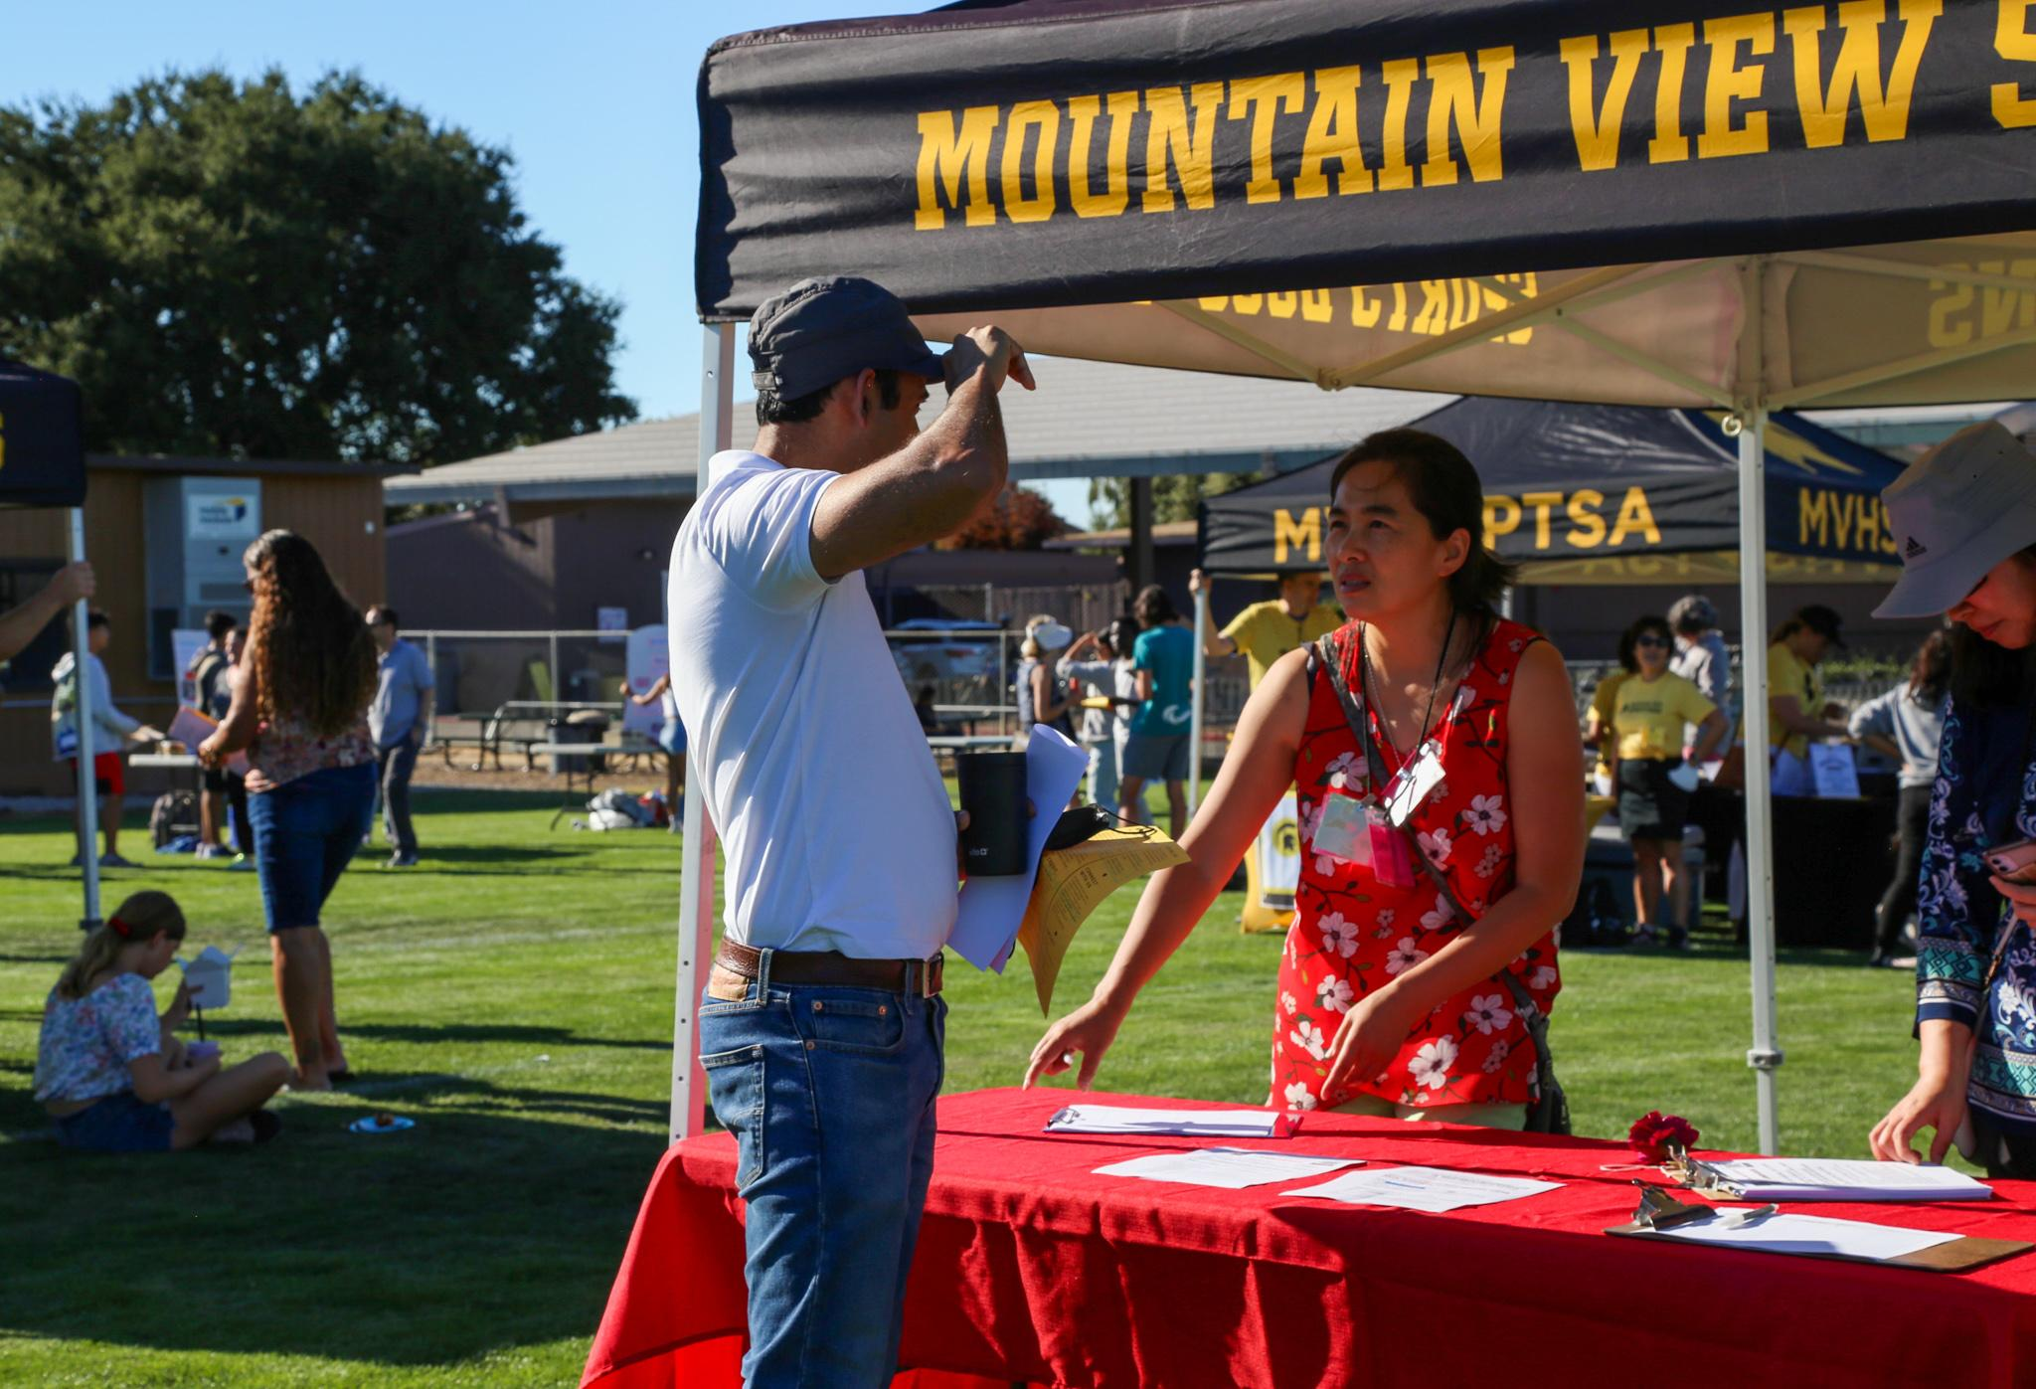
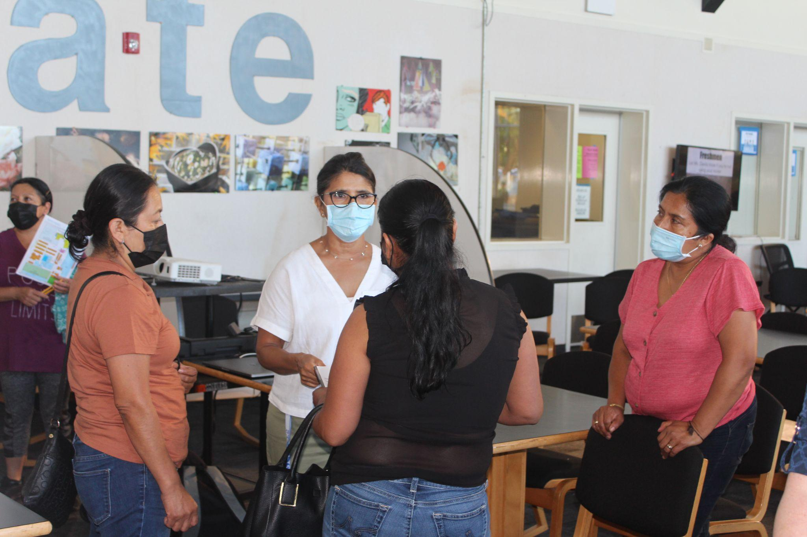
What Families Want from School Communication
The following was excerpted from a survey done by the National School Public Relations Association. You can find the full article from Edutopia here. (Unfortunately, the survey itself is no longer available from NSPRA.)
What News They Want
A great feature of this survey is that it divided parental responses into "elementary" and "secondary" categories, acknowledging the differences between those schools and students, which are often lumped together. But it turns out that when you are talking about what information parents want from teachers, most priorities are the same:
Updates on their child's progress or insight on how they improve
Timely notice when performance is slipping
Information on what their child is expected to learn during this year
Homework and grading policies
Rounding out the top five for elementary students was information on behavior (including how their child gets along with others), while for secondary students it was how to best communicate with the teacher.
Most parents and families are grateful to hear anything from home and we want to encourage opening the lines of communication early to begin establishing a positive, trusting, transparent relationship that is the foundation of a strong partnership.
3

Slide 5
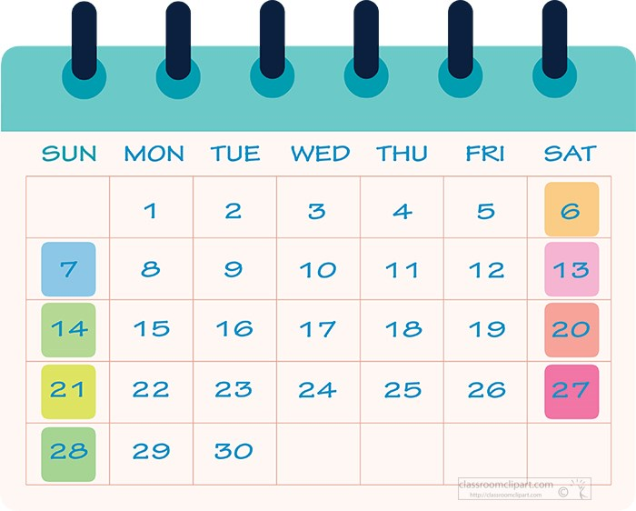
Timeline & Templates
4

Slide 6
Suggested Timeline & Outreach Information
Timeframe | What? | Resources:
Early August (Before/Immediately after school opens) | Consider a game, video, slide deck, Parent Square Post sent VIA ParentSquare to introduce yourself to students and their families. You could also request that students and their families contribute to a class slide deck… Ex. Get To Know MVHS | All District Technology Apps Screencastify, Canva for Ed, Kahoot, Peardeck, Slides, WeVideo, Youtube are all fun ways to make a virtual or digital introduction to your students and families before they ever meet you in person. Imagine how they will appreciate that effort to help relieve some of their nervousness about you!
Immediately following Back to School Night | After Back to School Night Recap of important information from your class. | See post BTSN “Template” in ParentSquare
Early September | First Newsletter to all Targeted Communication to families of students who may require more support | Templates in ParentSquare
First Prog Rpt Early/mid -September (send in addition to the required Progress Report) | During First Progress Reporting Send information (even if you already have) that is just about how to contact you to make parent teacher conference. | Parent teacher conference info Template in PS You can set up appointments in ParentSquare so parents and make appts easily with you.
End of Qtr 1 | Reminder invites to Parents to contact teachers for conference if desired | Same as above!
Monthly/New Unit of Study | Periodic Teacher Newsletter | LAHS: Teacher Newsletter Template MVHS: Teacher Newsletter Template
5

Slide 7
An Equity-based Approach
6

Slide 8
An Equity-Based Approach to Communication & Outreach
“Good for everybody. Essential for some.” Scott Townsend, EL Achieve
We know that our staff have a finite set of hours in the day and many competing demands on your time. In the same way that we are shifting our thinking about how to best meet the needs of students through a multi-tiered approach to Social-Emotional Wellness, that same idea can be applied to outreach and communication to families.
Most of our students and families’ needs for communication can be met through a whole-school and whole-class approach. However, using an equity framework requires that we spend a little more time on the students and families who may require additional support and communication to succeed at the same level as their peers.
As the teacher of the course, this is where your deep knowledge of your students plays a crucial role. You, along with the families, know the students best. Identifying students and their families who may benefit from more targeted communication from you early can go a long way to building the kind of necessary home to school partnership that struggling students need most in order to be fully engaged.
7

Slide 9
Culturally
Competent
Communication
8

Slide 10
Building Bridges
Remember that some students and families, especially non-English speakers, may need additional “encouragement” feeling connected to the school and to you!
You can help them by:
Letting parents know at the start of the year that you speak a language other than English, if you do!
using our free, simple language support tool, Language Line to access on demand interpreters over the phone, tablet or laptop.
understanding that trust and rapport is most likely going to be built through face to face or spoken communication (at least initially) versus emailing
always believing that parents want and appreciate information from you about their children
focusing on the families’ strengths as well as the students’ versus coming from a deficit perspective
understanding that in some cultures the ultimate sign of respect is not interfering with teachers and schools
being sensitive and gentle in your approach to families who may feel nervous or intimidated by teachers
being encouraging to families who don’t want to feel like they are “bothering” us
Tips for supporting non-English speaking families:
Build relational capacity with the family members by valuing the family’s native language. Use ParentSquare so they receive written communications in the language they are most comfortable with.
Be mindful of a variety of English literacy levels and use accessible language and tools (i.e. leave a voice message via Language Line interpreter if a live conversation is not an option.)
Offer to set up a parent-teacher conference without expecting a parent to initiate it.
9

Slide 11
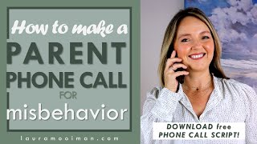
Building Bridges
Helpful Tips for Calling Home about Behavior
10

Slide 12
AERIES
Resources
11
11

Slide 13
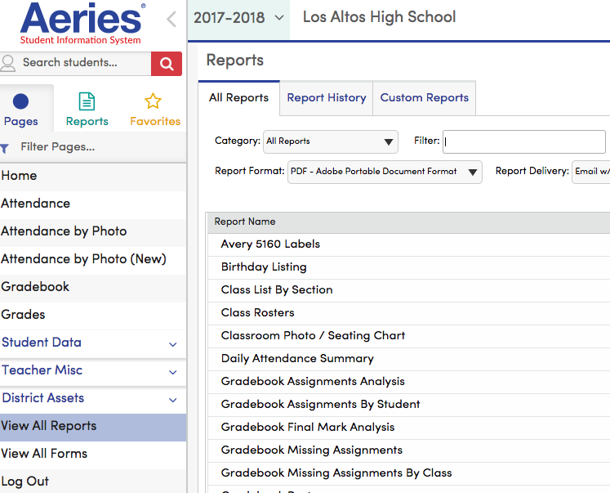
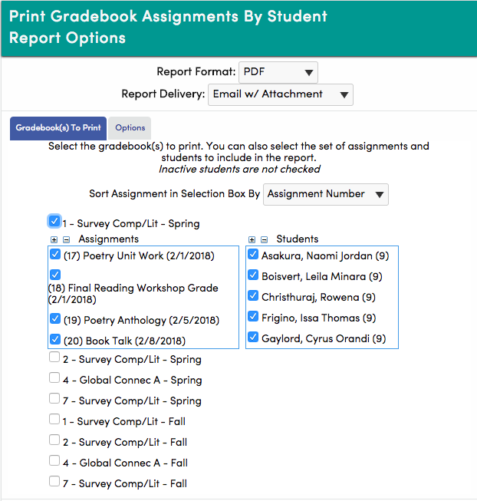
Using Aeries to send class email w/grade report
1. From your teacher account, PAGES, scroll down to DISTRICT ASSETS and click VIEW ALL REPORTS.
2. Once the box opens, click GRADEBOOK ASSIGNMENTS BY STUDENT to generate a grade report of all assignments with grades.
3. When the box opens check that REPORT FORMAT is PDF and DELIVERY is Email w/Attachment.
4. Choose ASSIGNMENT NUMBER to sort the assignments in the same order they are listed in your gradebook.
5. Check the classes and semesters that you want to include in the email blast.
6. Ensure all the assignments have a
7. Ensure that all the students in the class have a
Continue to next slide.
1
2
3
4
5
6
7
12

Slide 14
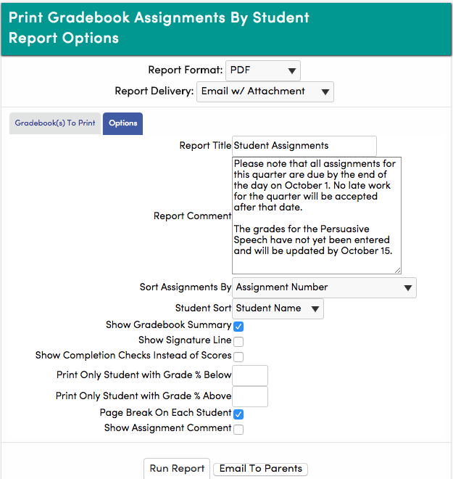
Using Aeries to send class email w/grade report
8. Click and open the blue OPTIONS tab.
9. You may add a note to the report that helps to clarify or provide more details about the grade report.
The email box will open and you can configure your email as desired.
10. Select options as you so desire.
11. Click EMAIL TO PARENTS to send reports.
8
9
10
11
13

Slide 15
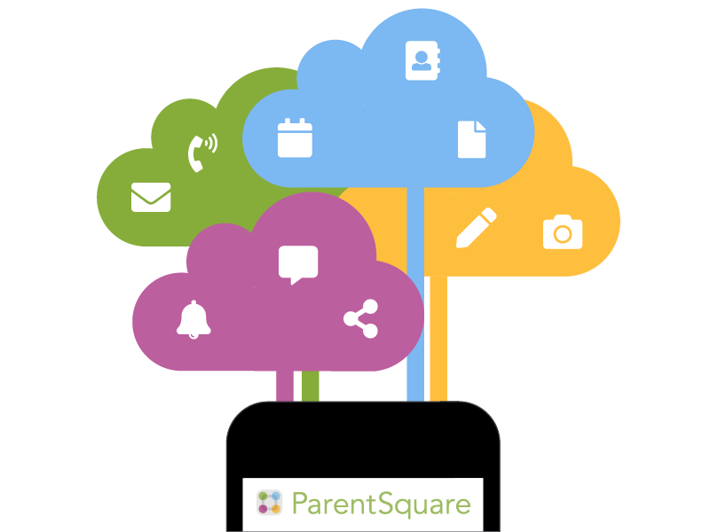
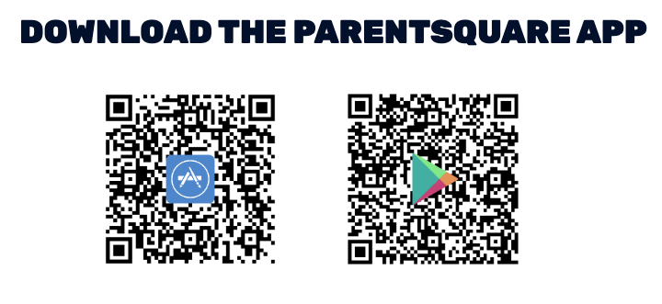
Parent Square
Resources
14

Slide 16
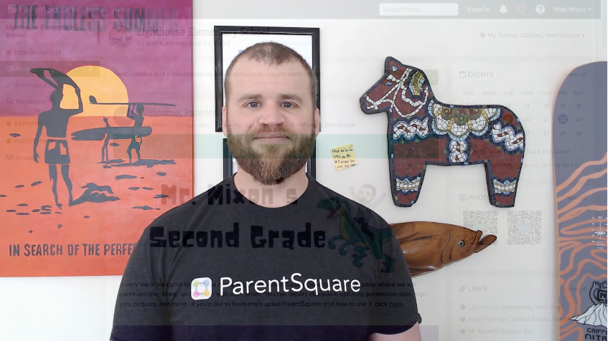
Communicating Home is so much easier with Parent Square!
Getting Started Playlist
Watch the Teacher Video - Navigation Basics
Assign a Co-Teacher, Room Parent or Assistant to your class
Send a welcome message post (See below for NEW! Studio Editor)
Add events to your class calendar
Send a private message to a parent
Post a class photo to ParentSquare
Upload forms and flyers to ParentSquare
Create a form or permission slip
Create parent-teacher appointment sign-up
Create a classroom wishlist
Create a volunteer sign-up post
Access your class directory
Create an after-school group in ParentSquare
Download the mobile app
Account Settings: Notifications, Language, Photo, Setting Office Hours
Getting Started Basics Video (with chapters)
Get Help Fast with Parent Square Chat!
I promise - they are very fast and helpful!
New Studio Editor is here!
Studio Editor Overview Video
Creating a Newsletter or post
More about Content Blocks
Studio Editor FAQ
15

Slide 17
Google Classroom
Resources
16

Slide 18
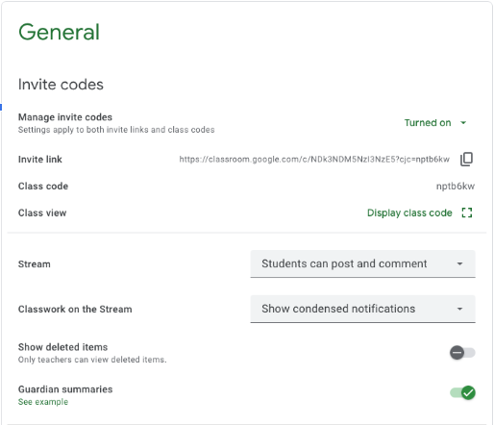
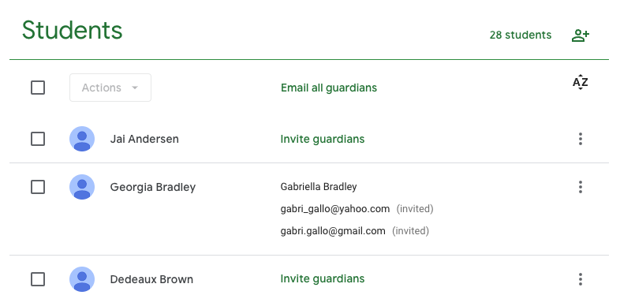
Parent Communication with Google Classroom
You can invite guardians to receive email summaries for their students. This feature is disabled by default. To turn it on, go to the Class Settings wheel in the upper right hand corner. Open it. Then scroll down to “General” and click “Guardian Summaries” to enable it.
Next, go to the People tab. Click on “Invite Guardians” for each student. There is no way to do this for all guardians at once. From this page you can also “Email All Guardians”. You can email all guardians even if they have not joined your classroom. They have 7 days to respond to the invitation before you have to resend it.
17

Slide 19
Canvas Resources
18

Slide 20
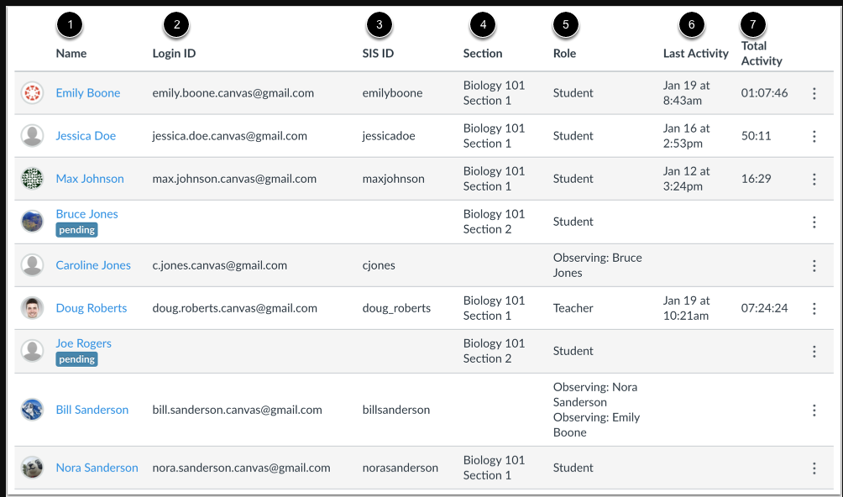
Adding Observers to Your Canvas Course
The only way parents/mentors/tutors can view a student in your Canvas course is through the manually invitation from you to view the course. You can view a detailed explanation of how to invite “observers” by clicking on the image below. Please note that you cannot add observers until your Canvas course status is PUBLISHED.
19

Slide 21
Language Line Information
20

Slide 22
Language Line - Phone Calls
21

Slide 23
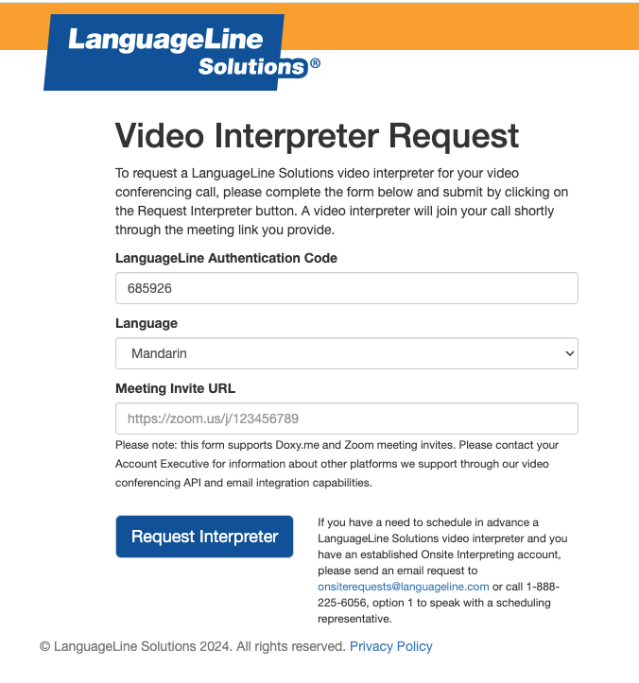
Language Line - ZOOM Video Meetings
To add a video interpreter to a Zoom Meeting, follow these steps.
Note: this only works with the following languages (for lesser often used languages not listed here, go to the next page):
Available M-F 6:00am - 5:00pm PDT
1.Go to virtualmeetings.languageline.com
2.Enter the Authentication Code: M4B6JBD9RB
3.Select the language for your meeting.
4.Add the Zoom URL for your meeting.
5.Wait for the Language Line interpreter to join your meeting.
6.The interpreter will give you their ID number and ask for some basic information about you: Name, School, and Department.
Be sure to begin this process a few minutes before your meeting starts.
22

Slide 24
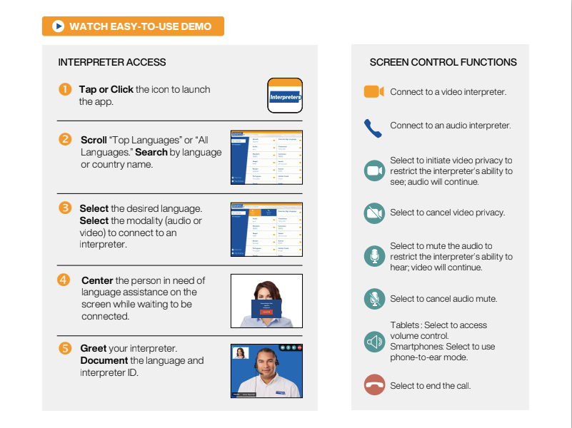
Language Line -Insight Video Meetings
To use the Insight video service you need to download the Insight App first. (So easy - it took me less than 30 seconds).
Laptop Device Downloads:
Go to https://insight.languageline.com/
Enter the Authentication Code: M4B6JBD9RB.
Name your device.
Follow the prompts to begin the session.
22

